Slide 1

Welcome to our clinic!

Slide 2
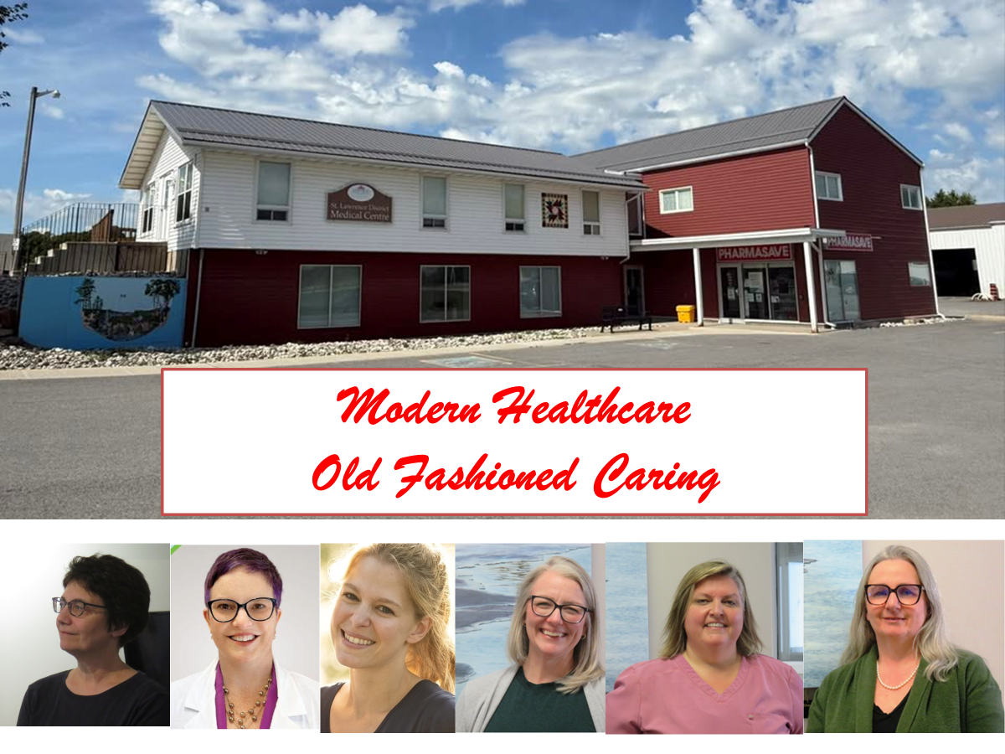

Slide 3
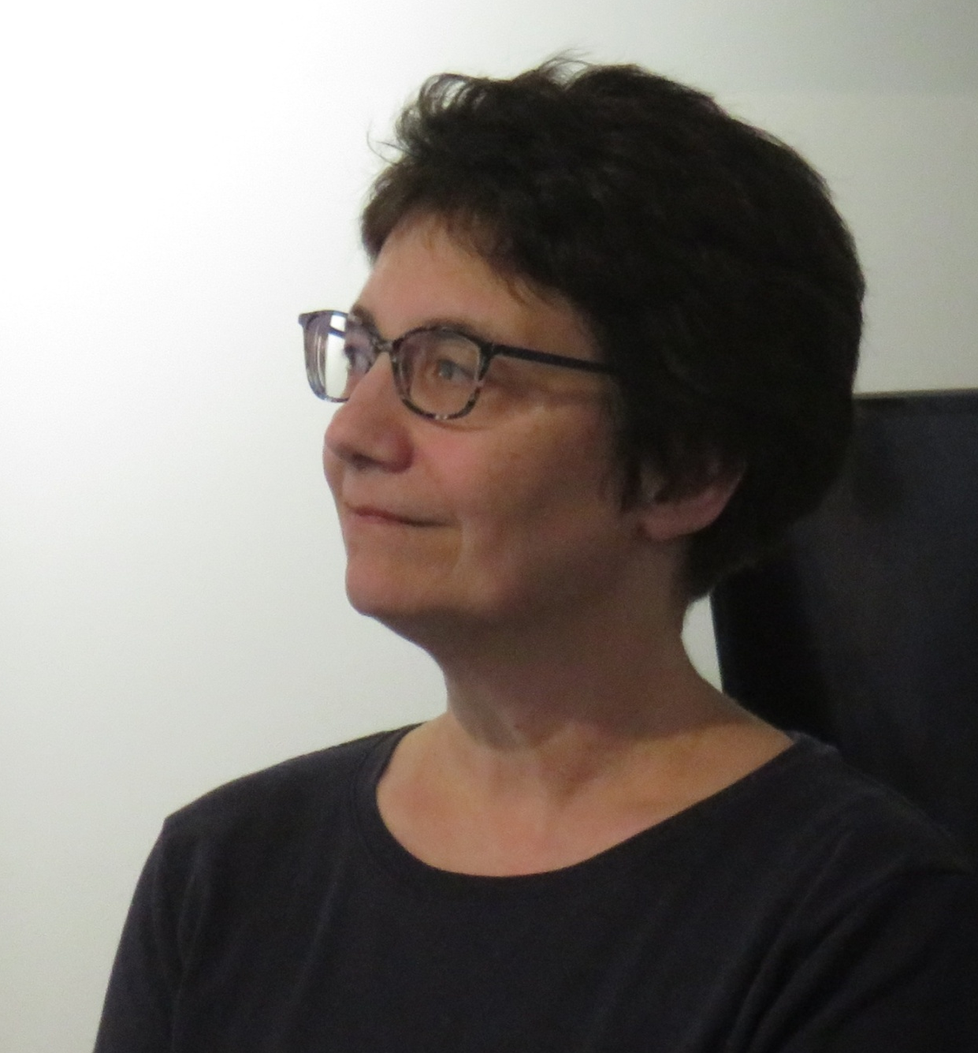
Meet them...
Dr. Karoon Samikian

Slide 4
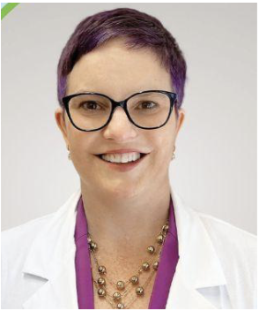
Meet them…
Dr. Tara Wakefield

Slide 5
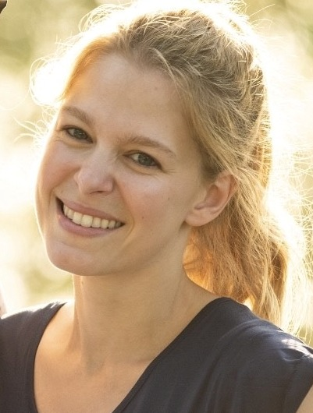
NURSE PRACTITIONER
JENNIFER REVELL

Slide 6
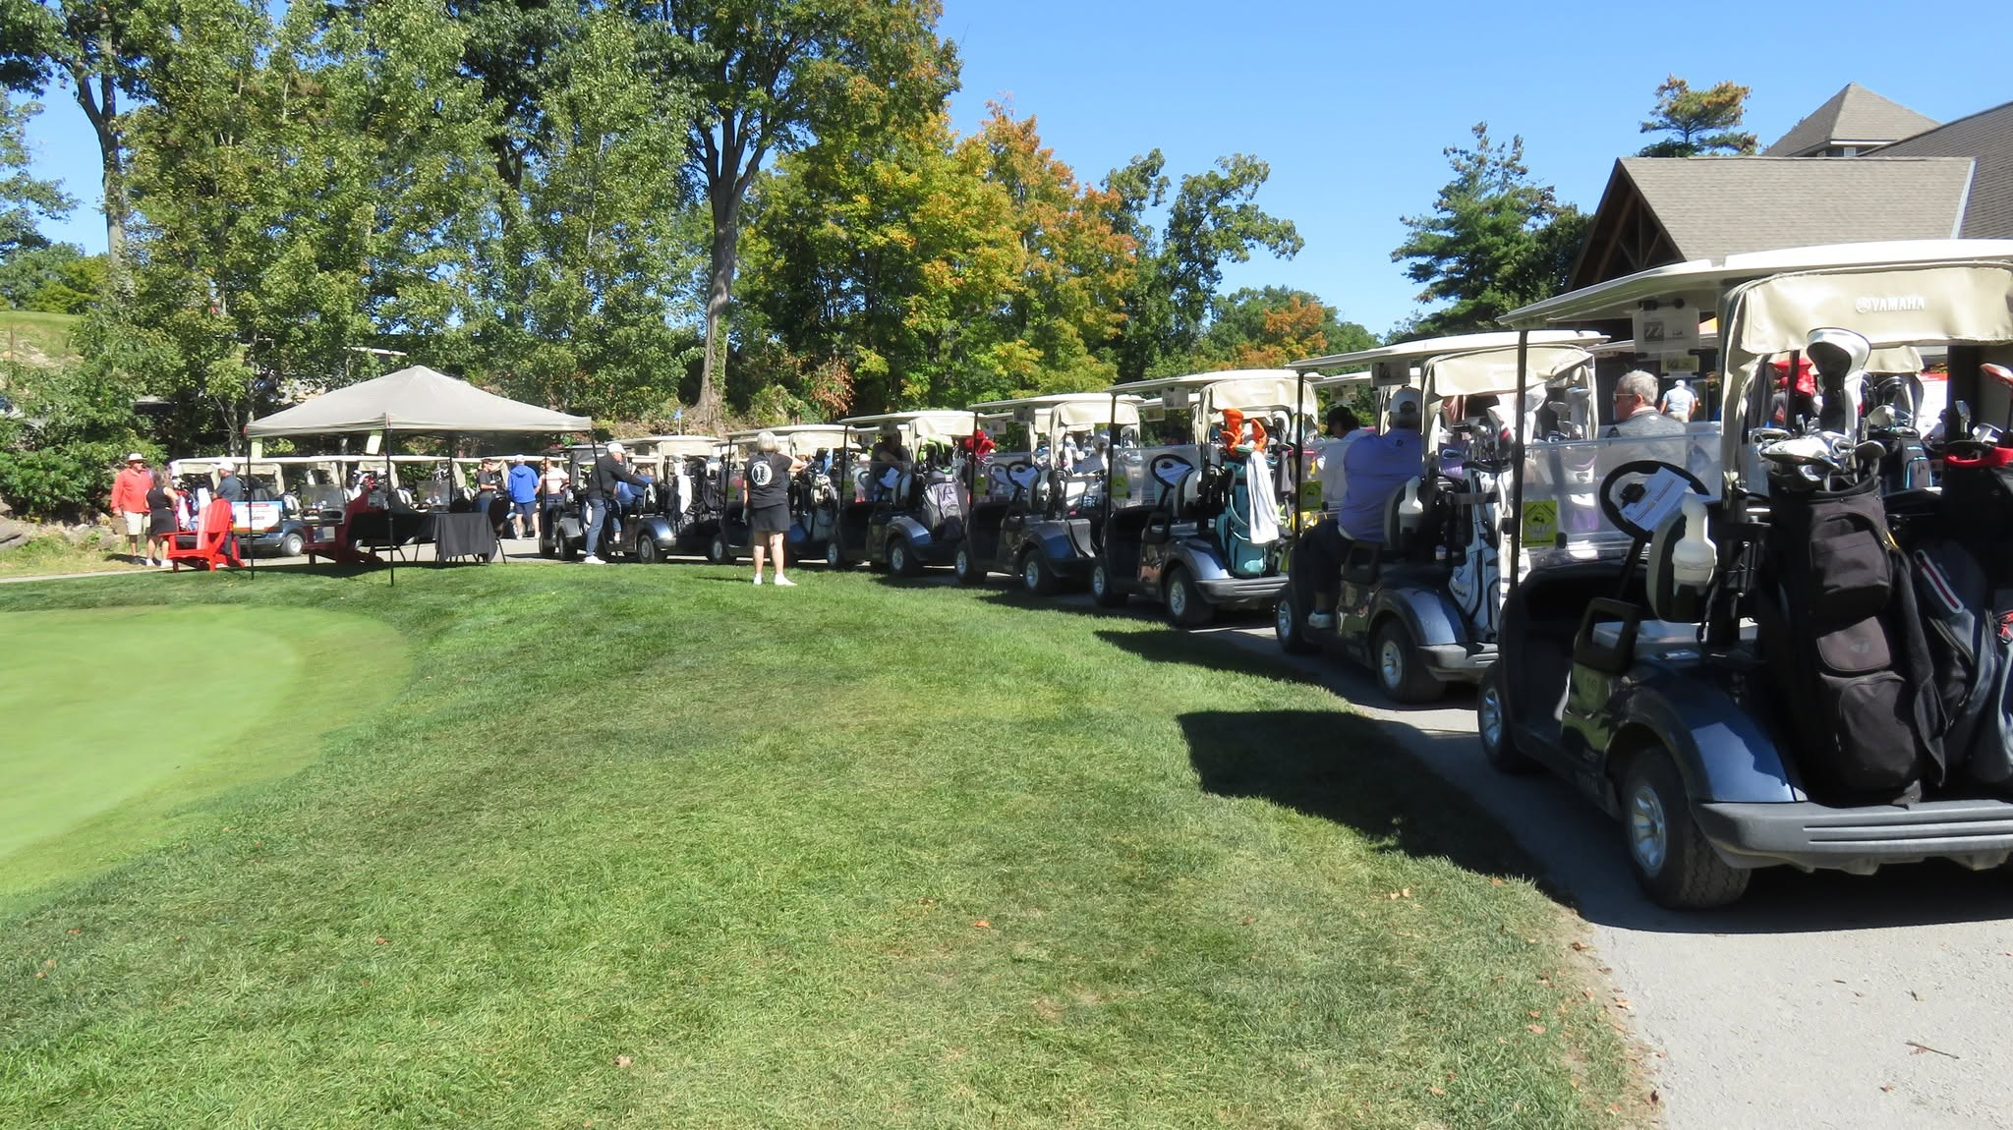

Inaugural Golf Tournament
Fundraiser for SLDMC
Raised $12,000.00

Slide 7
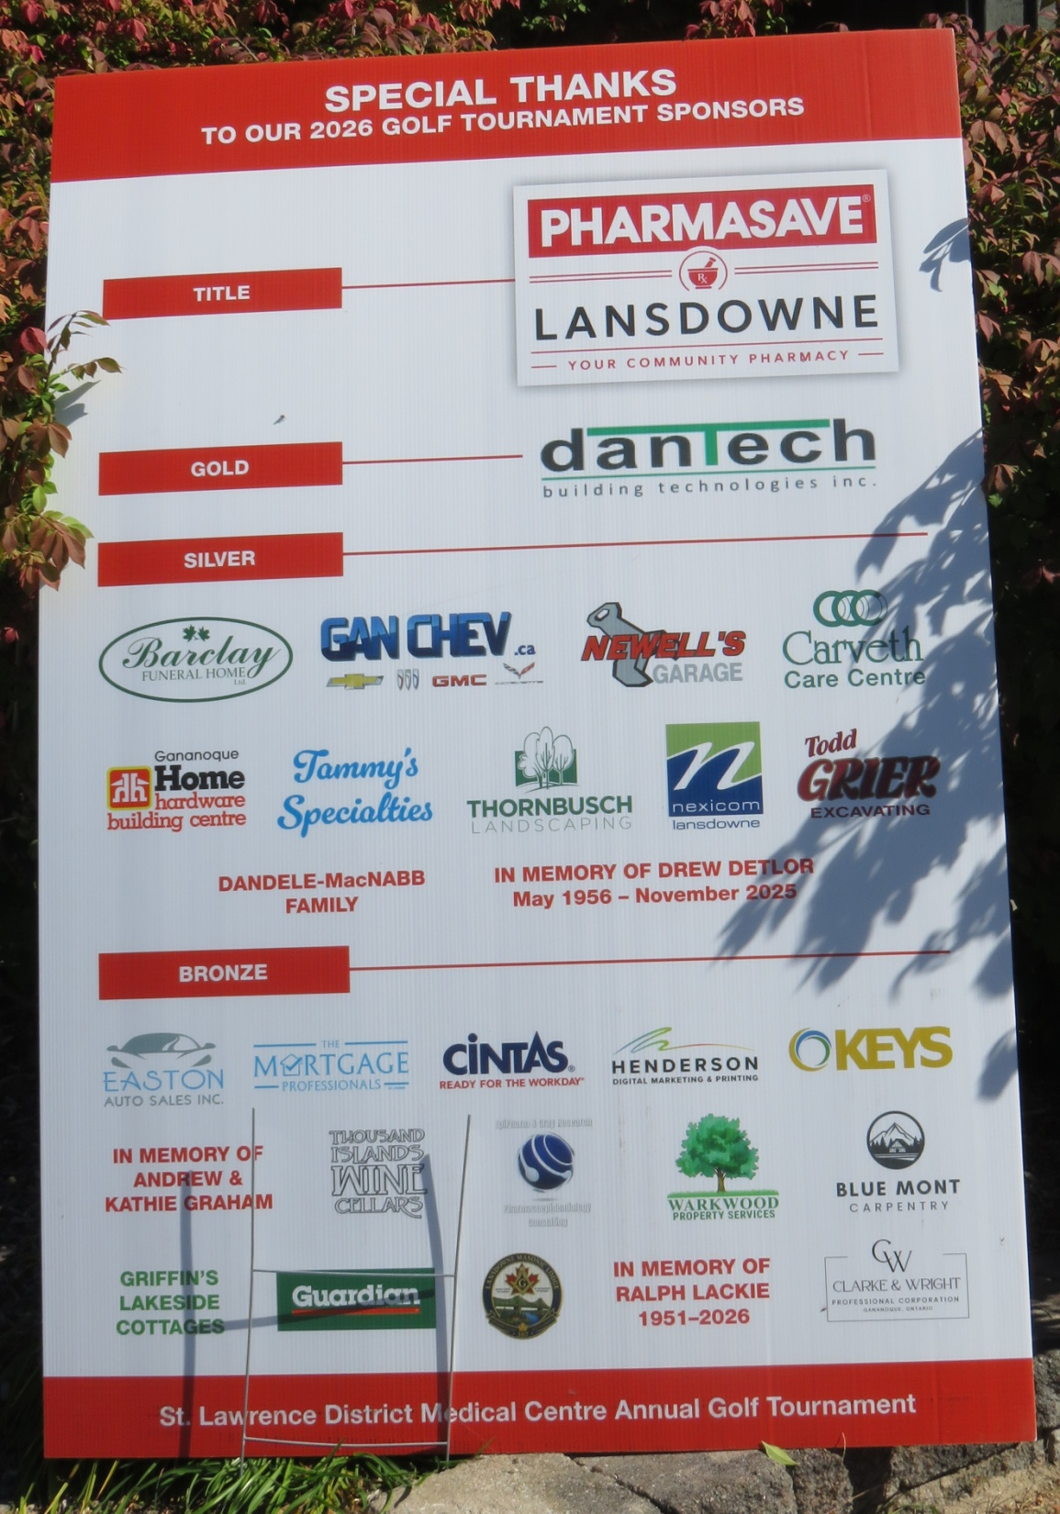

Slide 8
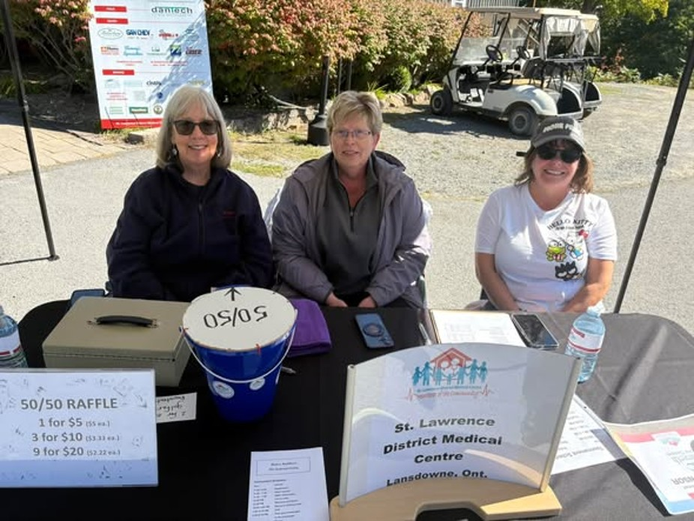
Volunteers Rock!

Slide 9

“We’re here for the view…”

Slide 10
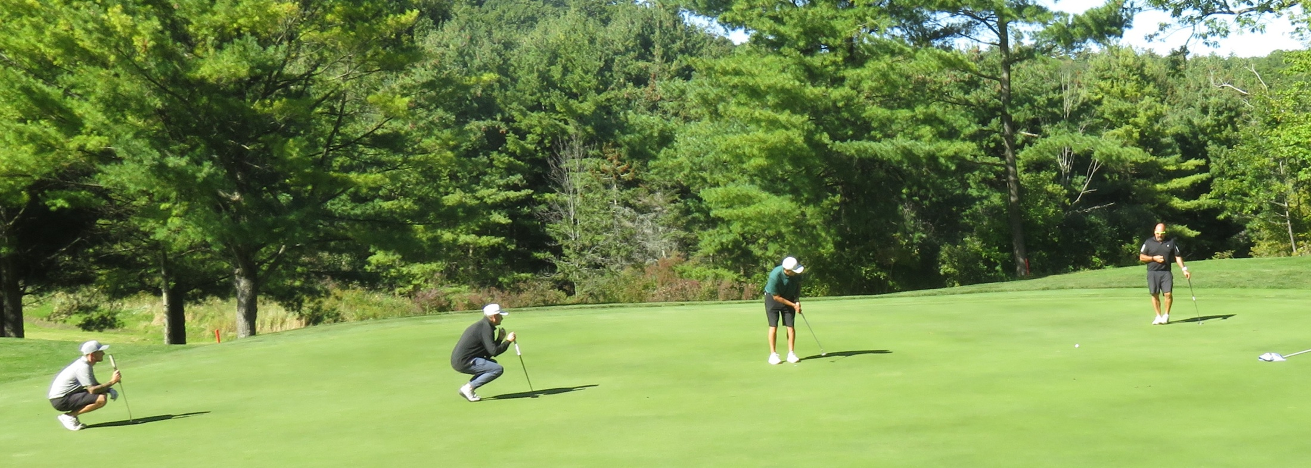
The epitome of teamwork!

Slide 11
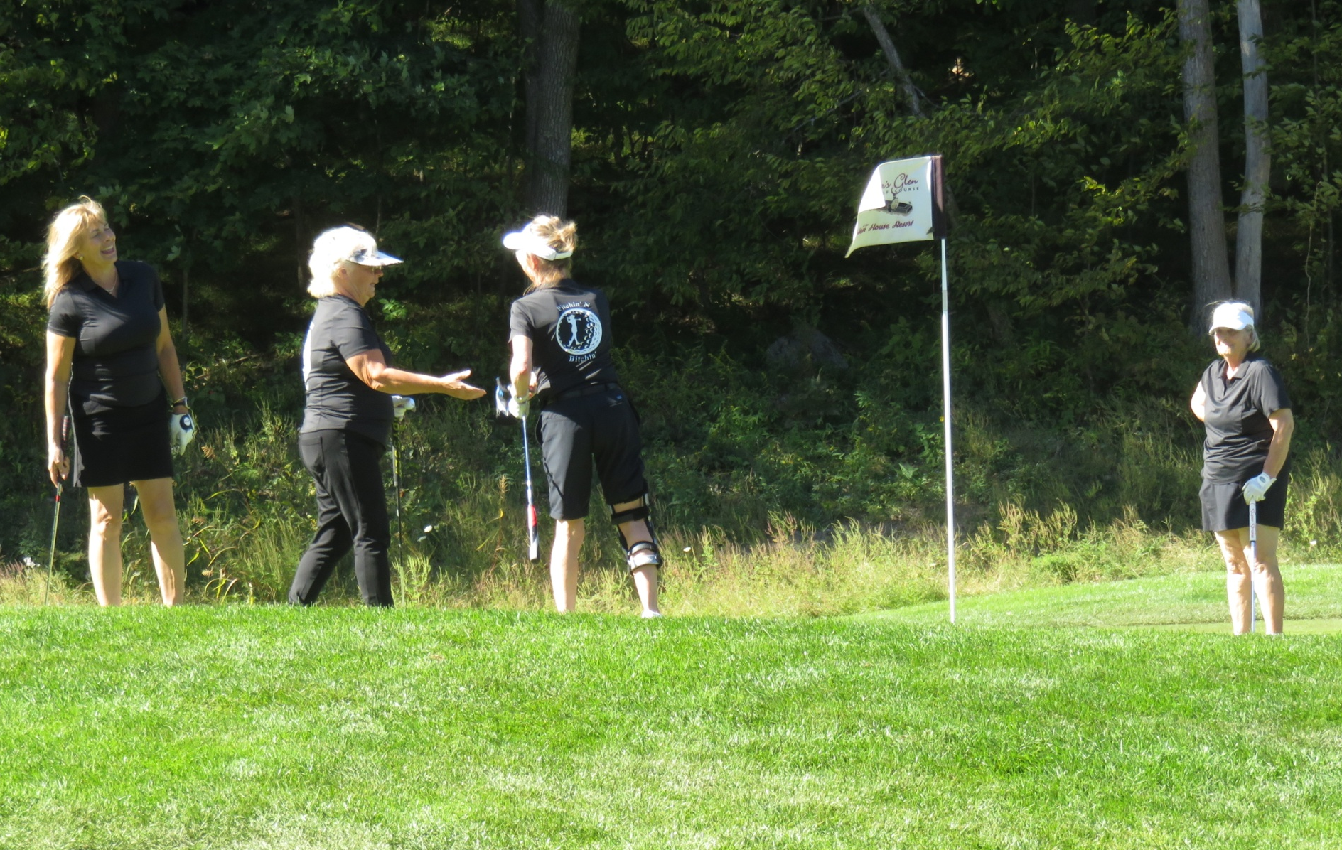
Give me the ball.
I can do it.

Slide 12


Slide 13
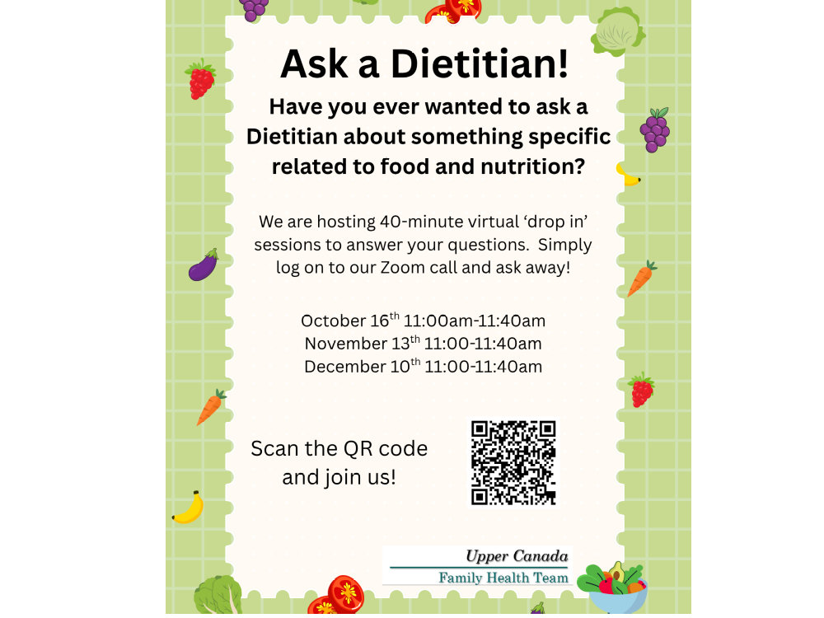

Slide 14
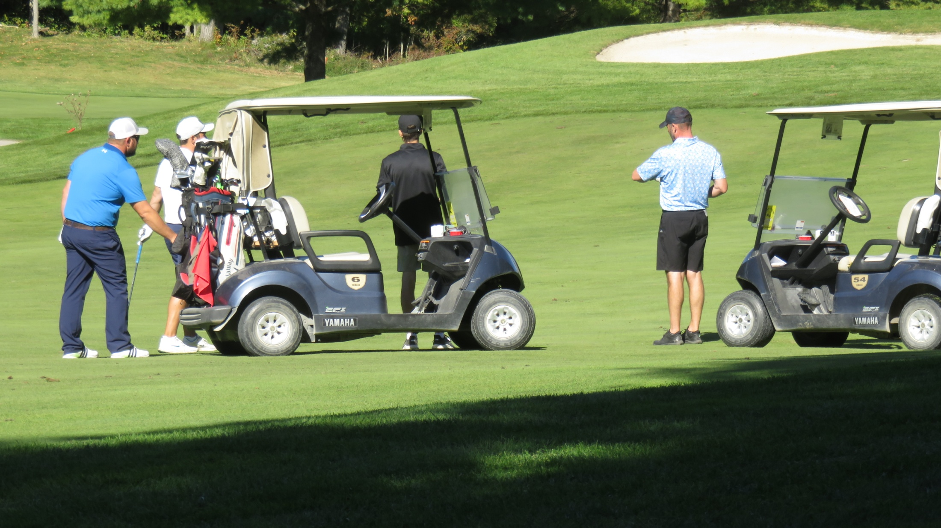
Winning team strategy meeting.

Slide 15
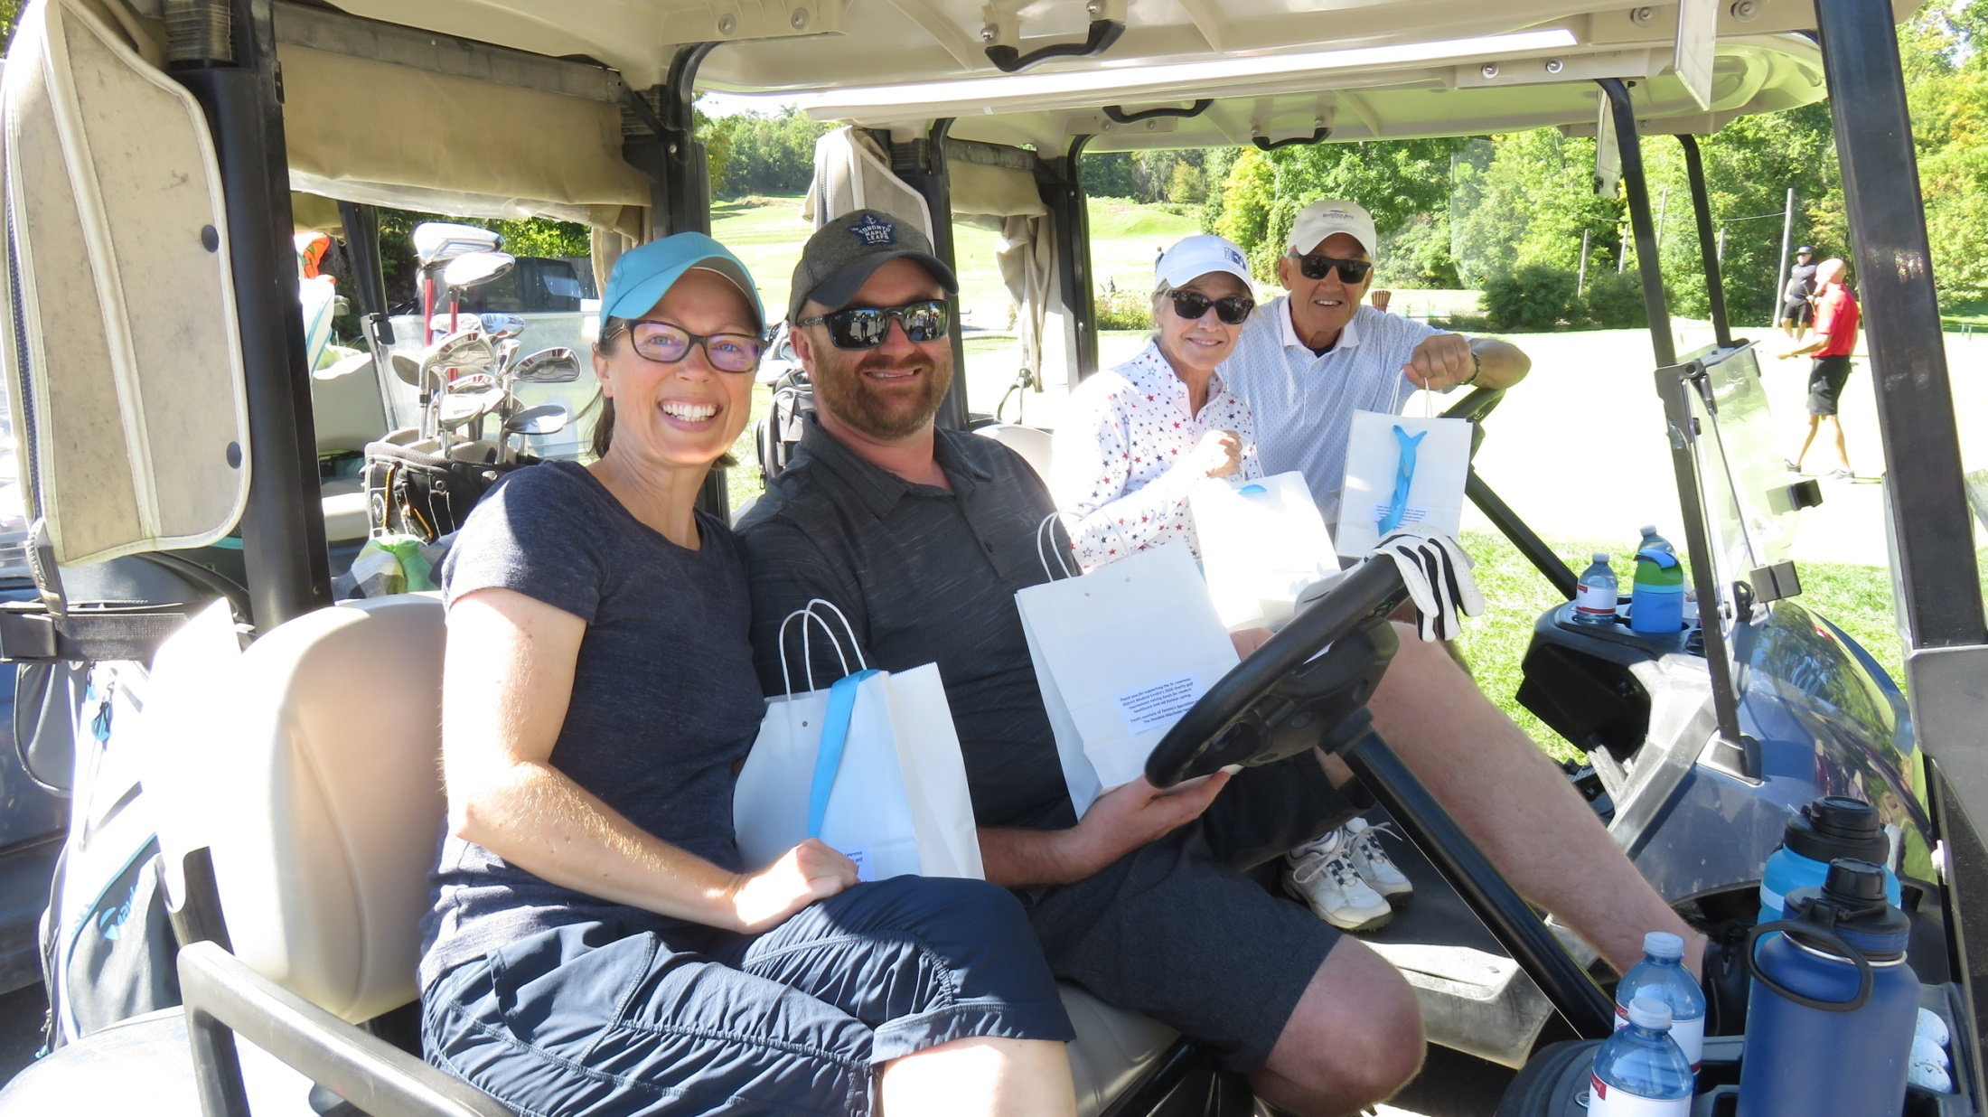
Treats for the course, compliments of
St. Lawrence District Medical Centre.

Slide 16
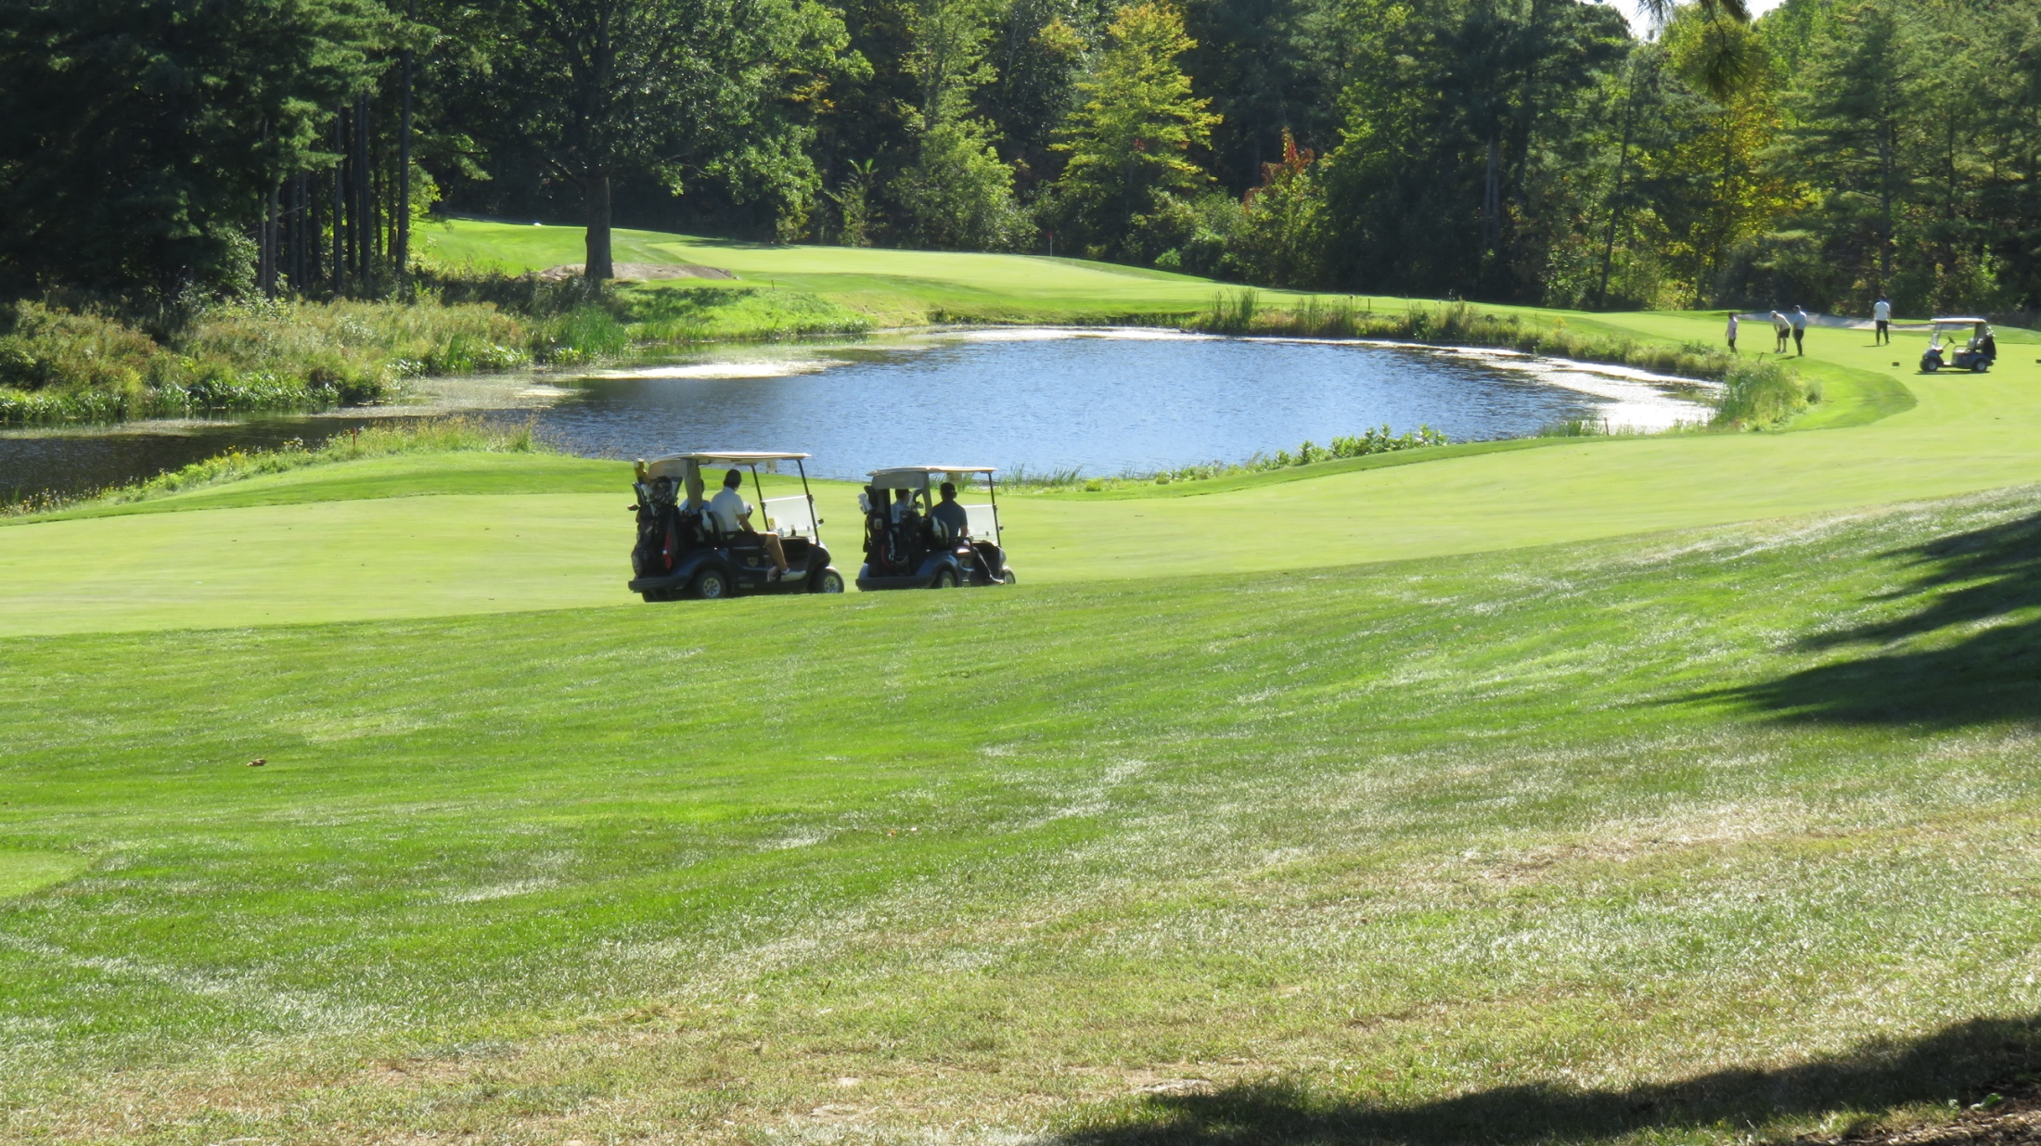
Next ball washing station just ahead.

Slide 17
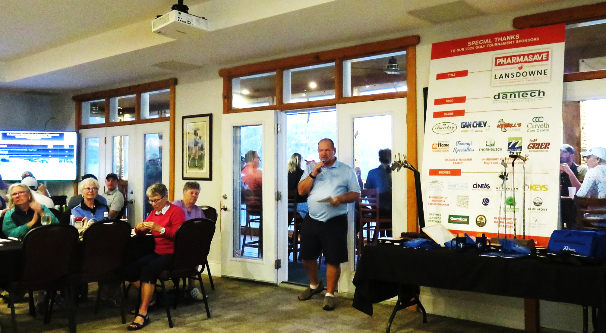
“Thank you for coming. Thank you to our hosts, Smuggler’s Glen.
It’s been a great day, raising money for the Centre.”
Next year -Thursday, September 23rd, 2027
Mark your calendars. Plan to play.

Slide 18
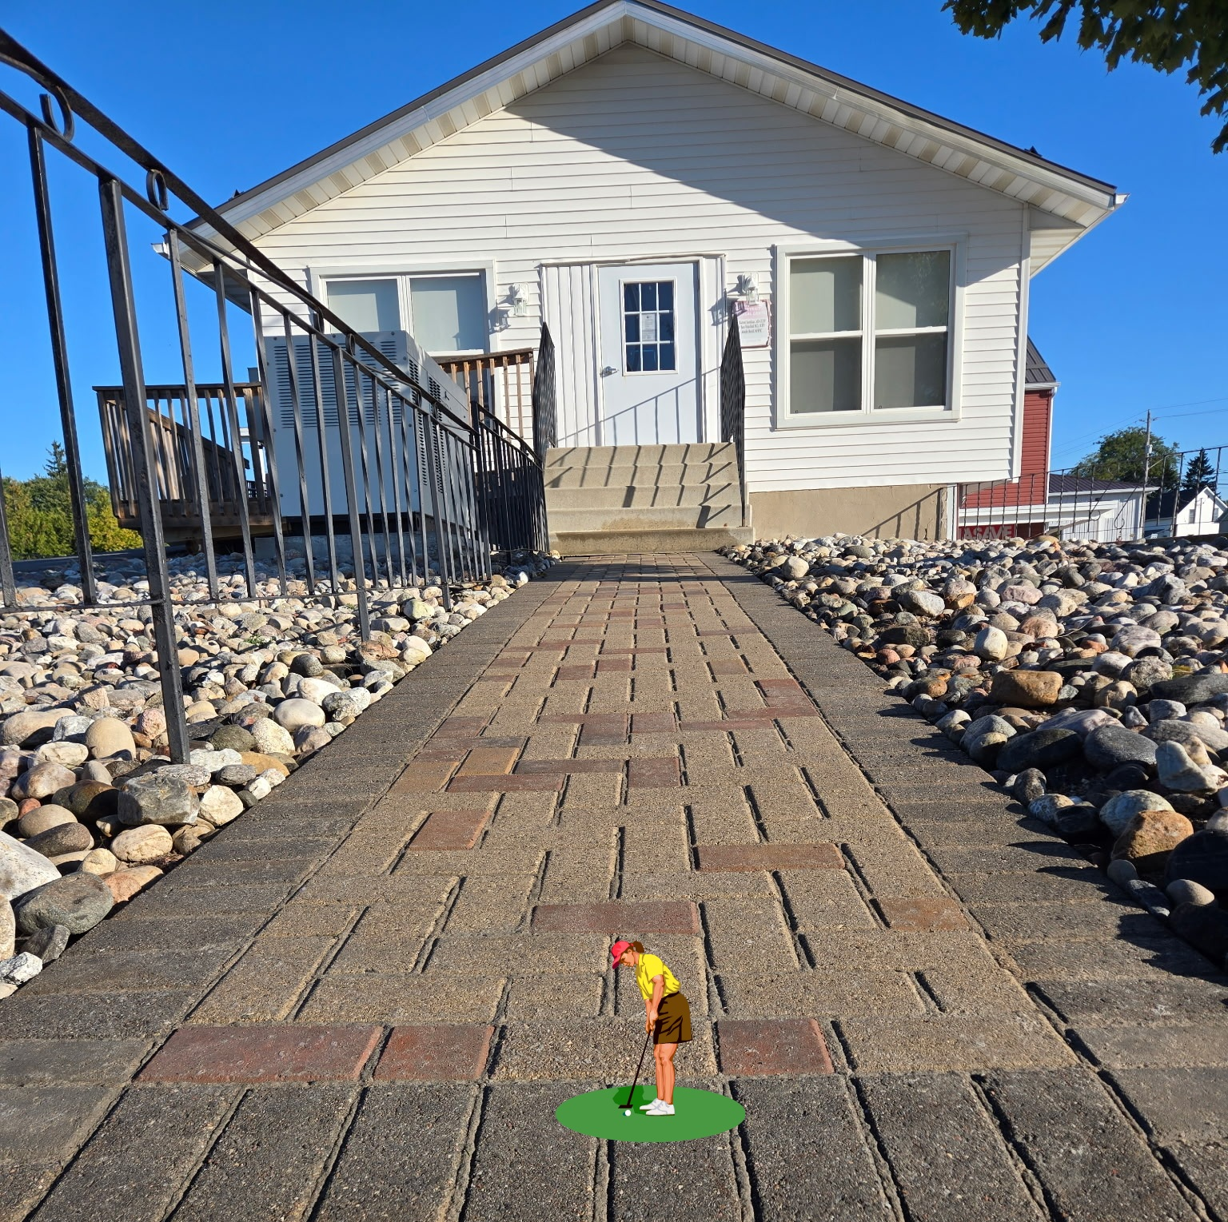

While we were golfing, Thornbusch Landscaping was here
donating time and materials to restore the south entrance
step and walkway! Thankyou Paul.

Slide 19
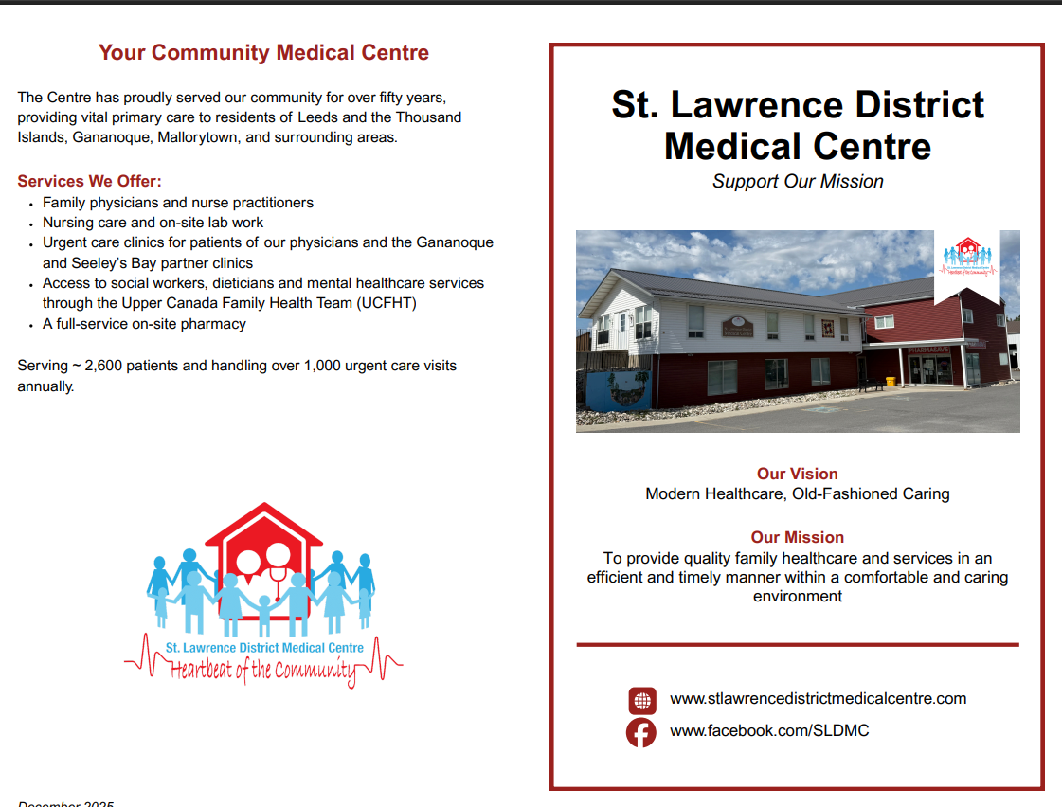

Slide 20
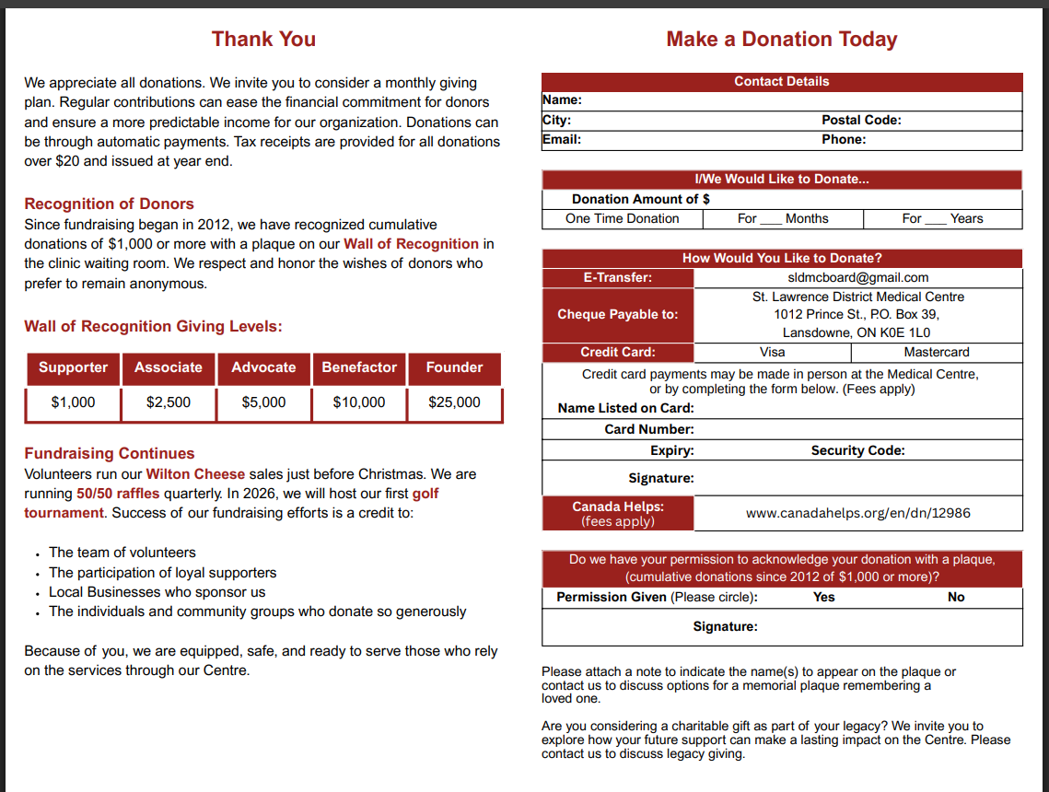

Slide 21


Slide 22
Ask For A Referral
As a patient of the SLDMC you have access to a variety of allied health services delivered on site by the Upper Canada Family Health Team

Slide 23
UPPER CANADA Family Health Team
Services delivered on site.
Ask your doctor for a referral to the program.
Preventative Care: cervical cancer screening, Ontario Breast Cancer Screening Program referral information, colon cancer screening kits.

Slide 24
UPPER CANADA Family Health Team
Services delivered on site.
Ask your doctor for a referral to the program.
Dietitian: nutritional support for chronic disease management, weight loss, eating on a budget, recipes, label reading, digestive concerns, and more!

Slide 25
UPPER CANADA Family Health Team
Services delivered on site.
Ask your doctor for a referral to the program.
Smoking Cessation: support for those >18yr to quit smoking with the use of nicotine replacement therapies, medications, and supportive counselling for other smoking cessation strategies.

Slide 26
UPPER CANADA Family Health Team
Services delivered on site.
Ask your doctor for a referral to the program.
Social Work: individual supportive counselling for mild to moderate mental health challenges including life changes and stressors, anxiety, grief, low mood, sleep difficulties, low self-esteem, depression, etc.

Slide 27
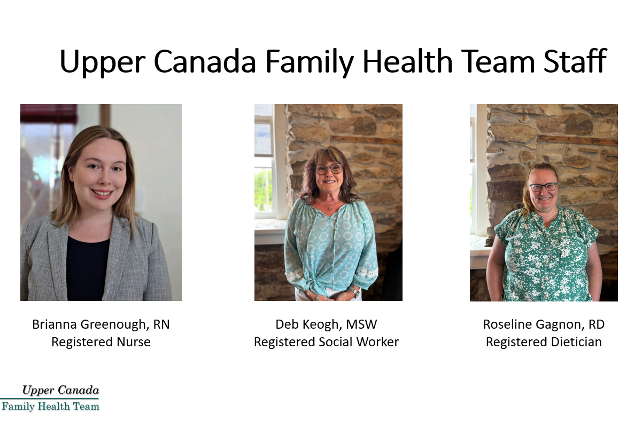

Slide 28
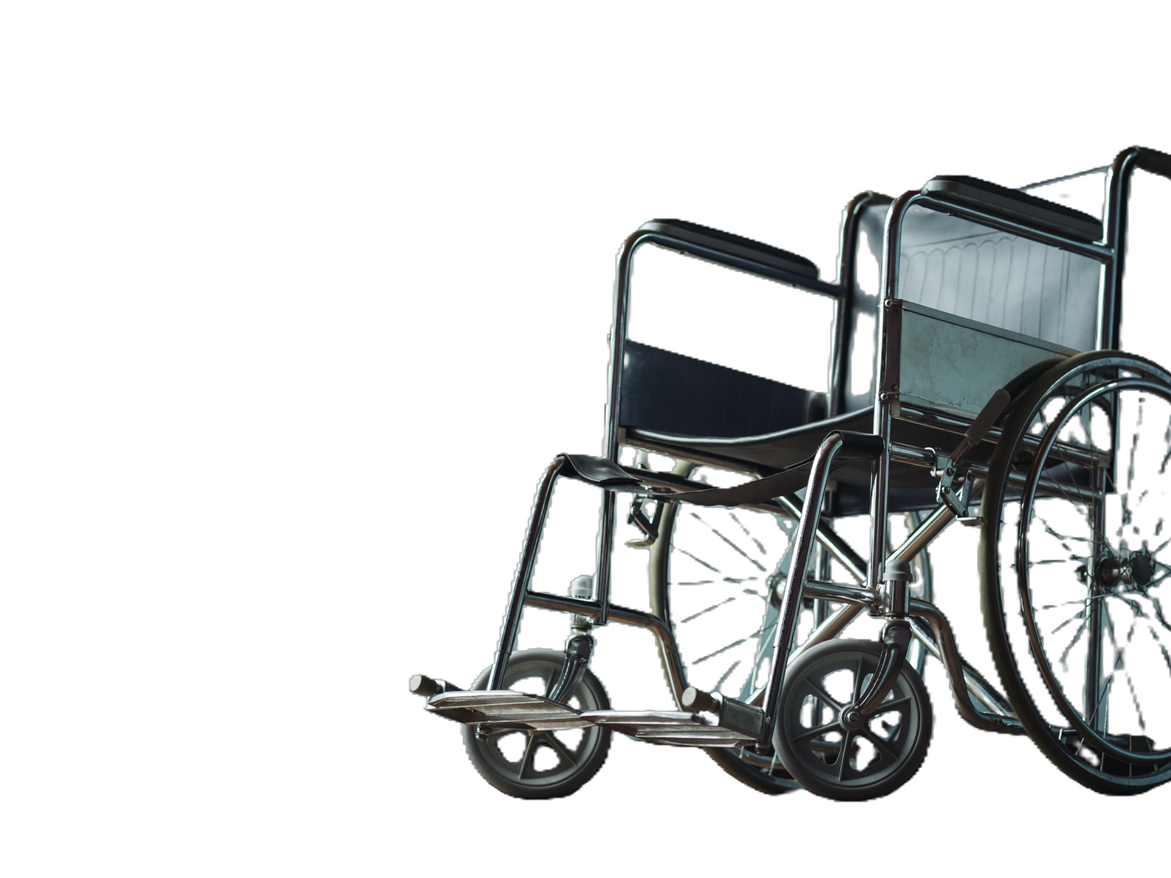
Assistive Devices Lending Cupboard
St. Luke’s Leeds Anglican Church
18 Main St., Elgin
Access to walkers, canes, commodes, bath seats, and more at no cost.
Phone: 613-507-3311 (Parish Office) or
613-540-1684 (Cupboard Co-ordintor).
Website: St. Luke's Leeds Anglican Church

Slide 29
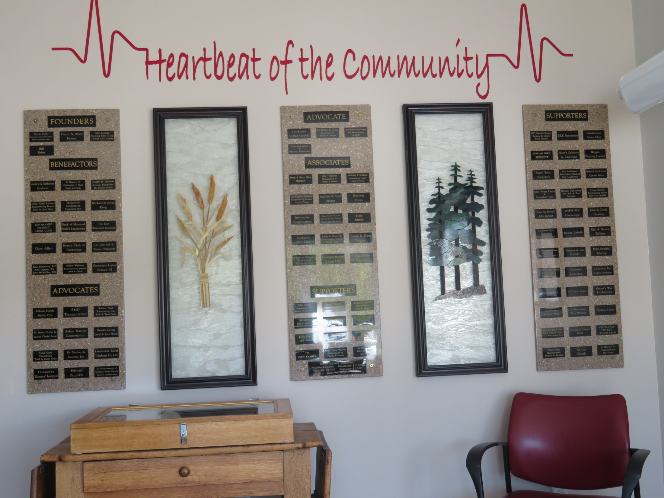
Excuse the state of our donor wall…
We will be reinstalling our plaques
and making room to acknowledge
many new donors. Thank you so much for making space for plaques an issue!
Pardon the state of our donor wall, we are currently adjusting to make room for additional donor plaques. What a wonderful issue to have!

Slide 30

50/50 LOTTERY
RAFFLE
October 1- 31, 2026

